Slide 1
Introduction

Slide 2
Description of project

Slide 3
Why we chose this project?

Slide 4
What roles team members played?

Slide 5
About our data

Slide 6
Core Goals & Stretch Goals

Slide 7
Agile – Project plan & Sprint breakdown
Add YouTrack Report - Manju

Slide 8
Core Goal 1 - CNN

Slide 9
Core Goal 2 - FasterRCNN

Slide 10
Core Goal 3 - YOLO
History and architecture
Used for classification, classification + localization, multiple objects (detection)
Runs fast and therefore can be used for realtime object detection.
Prior detection systems repurpose classifiers or localizers to perform detection. They apply the model to an image at multiple locations and scales. High scoring regions of the image are considered detections.
We use a totally different approach. We apply a single neural network to the full image. This network divides the image into regions and predicts bounding boxes and probabilities for each region. These bounding boxes are weighted by the predicted probabilities.
Our model has several advantages over classifier-based systems. It looks at the whole image at test time so its predictions are informed by global context in the image. It also makes predictions with a single network evaluation unlike systems like R-CNN which require thousands for a single image. This makes it extremely fast, more than 1000x faster than R-CNN and 100x faster than Fast R-CNN.
What's New in Version 3?
YOLOv3 uses a few tricks to improve training and increase performance, including: multi-scale predictions, a better backbone classifier. YOLOv3 uses multi-label classification. For example, the output labels may be “pedestrian” and “child” which are not non-exclusive. (the sum of output can be greater than 1 now.) YOLOv3 replaces the softmax function with independent logistic classifiers to calculate the likeliness of the input belongs to a specific label. Instead of using mean square error in calculating the classification loss, YOLOv3 uses binary cross-entropy loss for each label.
Darknet
Darknet is an open source neural network framework written in C and CUDA

Slide 11
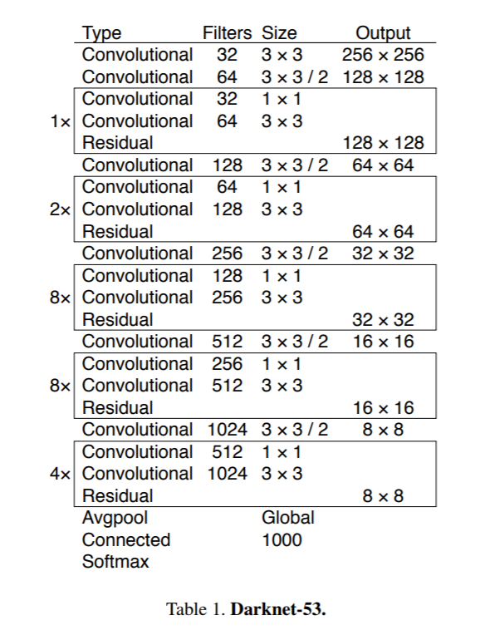
Core Goal 3 - YOLO
Architecture
Draw Grid and explain output grid
Evaluate object localization using iOu
Use non max suppression

Slide 12
Core Goal 3 - YOLO
Approach taken
Python
Pre-trained model – Momo image and video (include images and videos)
Limits on local machine, used ARGO
Used Darknet preexisting weights to train
Frozen layers to reduce spikes in loss , followed by unfrozen layer
Call back functions to change learning rate and stop training if gains are leveled out.
Multiple trainings – different hyperparameters (due to cluster limitations, improving results)

Slide 13
Core Goal 3 - YOLO
Results:
Tensor Board output
Comparison between models created
Model | Characteristics/ Hyperparameters | Time taken to train | Validation Loss | Detections on set of 8 images | Multi-Object detection | Incorrect detections | Detection on 2 videos
10+10nonfreeze_32_10batch
10+10nonfreeze_32_10batch_fullset
25Epochs, 64 Batch size, 3 Classes starting with 0
50Epochs, 64 Batch size, 3 Classes starting with 0
20190711-175339_929718_20E32B_50E_10B
20190711-194444_929750_20E32B_50E32B
20190714-15095750E_32B_ValSplit.2_Darknet
20190714-220626100E_32B_ValSplit.1_Darknet
20190717-22182815FE_100E_32B_ValSplit.1_Darknet
20190723-19191315FE_50E_10B_ValSplit.1_Darknet
20190724-23420315FE_50E_32B_ValSplit.2_Darknet
events.out.tfevents.1564118979.NODE081.orc.gmu

Slide 14
Core Goal 3 - YOLO
Results:
Sample images
Sample videos

Slide 15
Core Goal 3 - YOLO
Results:
Why the difference?
Insufficient images? w/ bounding boxes?
Quality of variance in character position in images?
Lisa vs Maggie
Additional Data augmentation methods – jitter, flip (one direction) included
Anchor box K means
Frames per second
Challenges faced?
Overall experience
Time taken averages
Experience with ARGO
OOO, H5 file issues,
Multi-GPU issues

Slide 16
Core Goal 4 - SSD

Slide 17
Stretch Goals #1

Slide 18
Stretch Goals #2 – Apply Image detection algorithm on videos
YOLO Video

Slide 19
Stretch Goals #3

Slide 20
Stretch Goals #4 – Cloud Computing
Zegang & Yinchen
Focused on AWS compute services

Slide 21
Stretch Goals #4 – Cloud Computing
Focused on exploring AWS Managed Service – Sagemaker
Used Out of Box AWS prebuilt object detection algorithm to train model
On Homer Simpson
Uses Sagemaker Notebook, Sagemaker Training, Sagemaker Inference/Hosting
Next steps:
Train on all characters
Improve detection by modifying hyperparameters
Challenges:
Data prep
Service Quota increase for ML instances

Slide 22
With more time…

Slide 23
Challenges / Learnings

Slide 24
Applications for this concept/research/work
Tad

Slide 25
References
Tad

